Slide 1
An implicit 1D Shallow Water Equation Solver using SciML
Computational Science NL Hackathon 2025
Swapan Madabhushi Venkata, Koen Mesman,
Arne Wulff, Philip Wurzner
June 14th, 2025

Slide 2


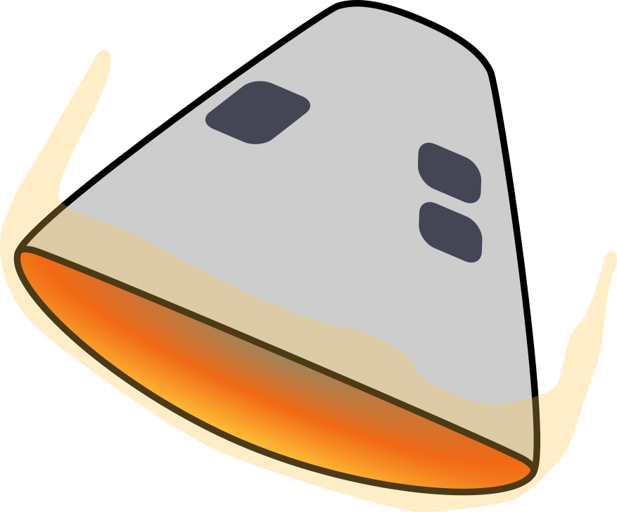



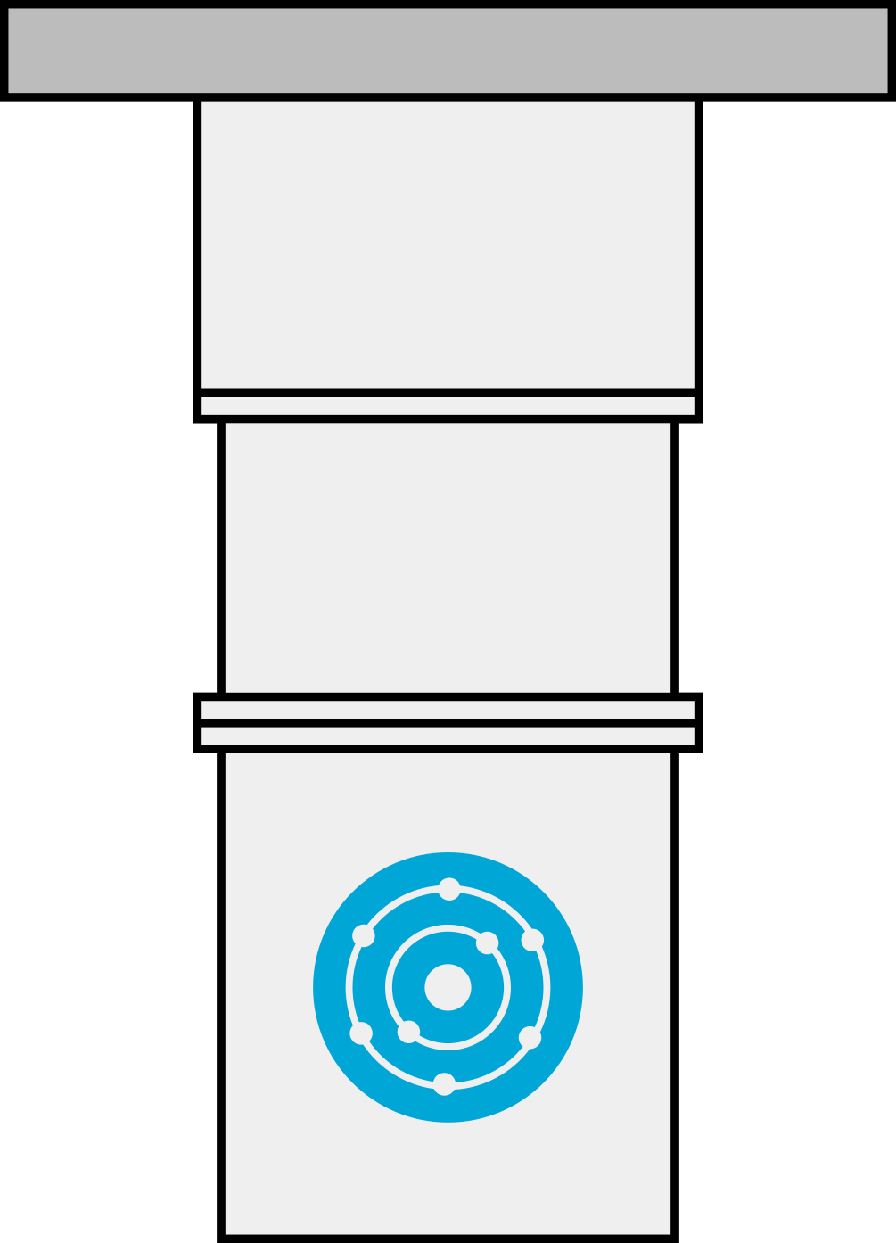

Quantum-enhanced Artificial Intelligence for sustainable Materials and Structural design in aerospace
Faculty of Aerospace Engineering
Faculty of Electrical Engineering, Mathematics & Computer Science

Slide 3
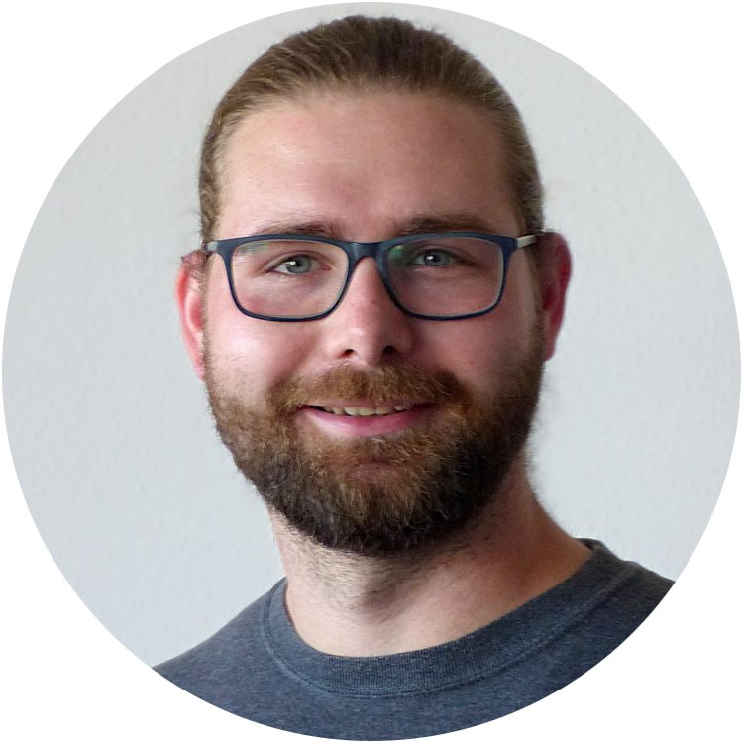
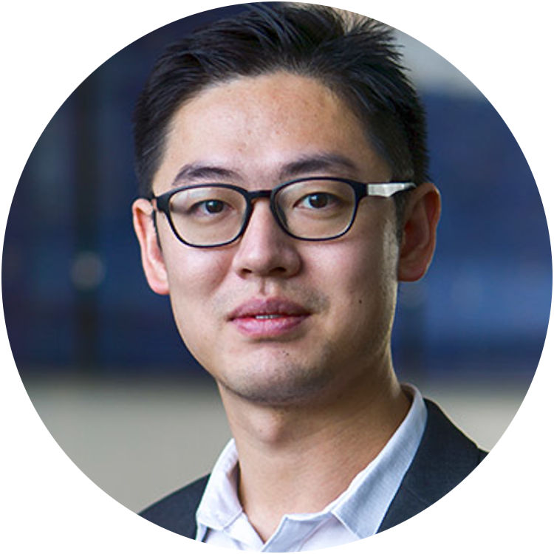
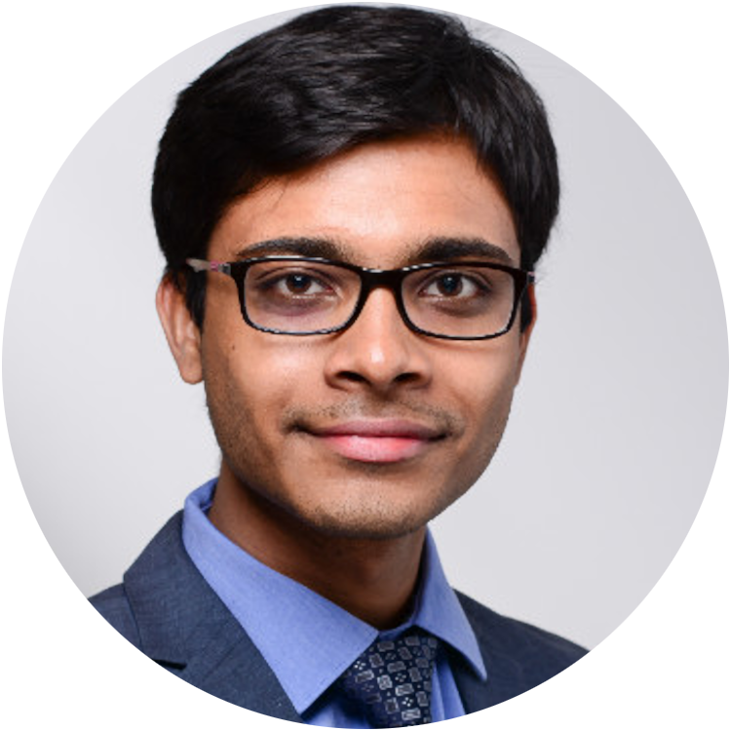


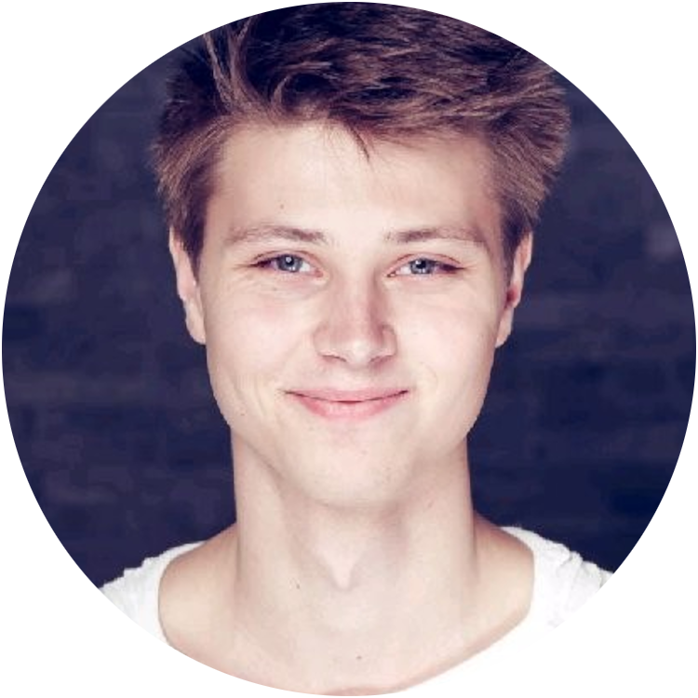



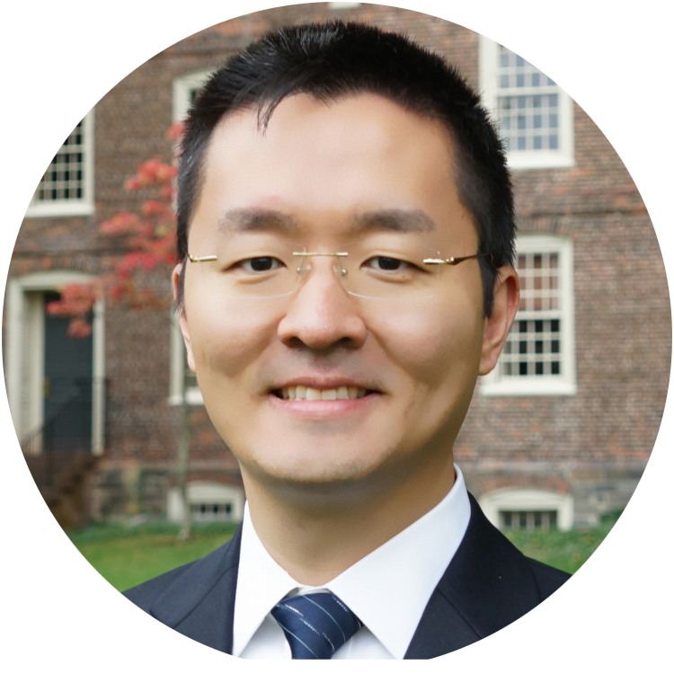
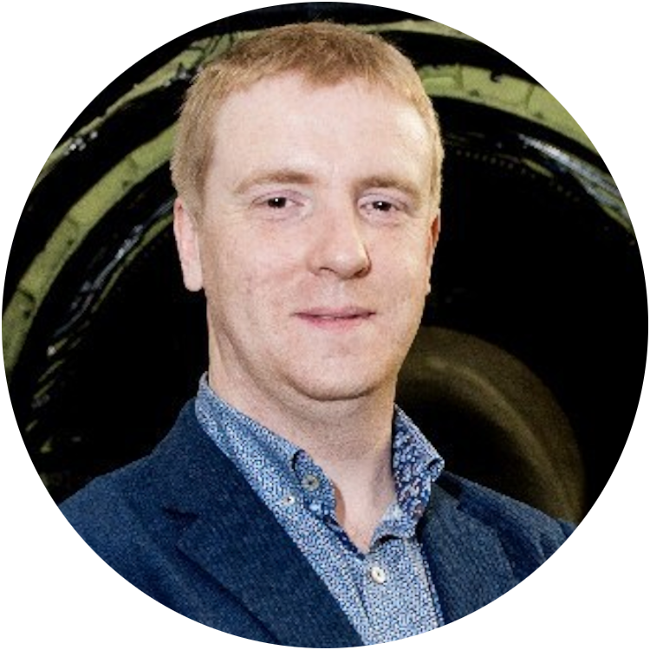
Arne Wulff
Boyang Chen
Associate Professor
Swapan Madabhushi Venkata
PhD candidates
Supervisors
Sebastian Feld
Assistant Professor
Koen Mesman
Matthias Möller
Associate Professor
Philip Würzner
Yinglu Tang
Assistant Professor
* Arizona State University
Qi-Jun Hong
Assistant Professor *
Roeland De Breuker
Associate Professor

Slide 4
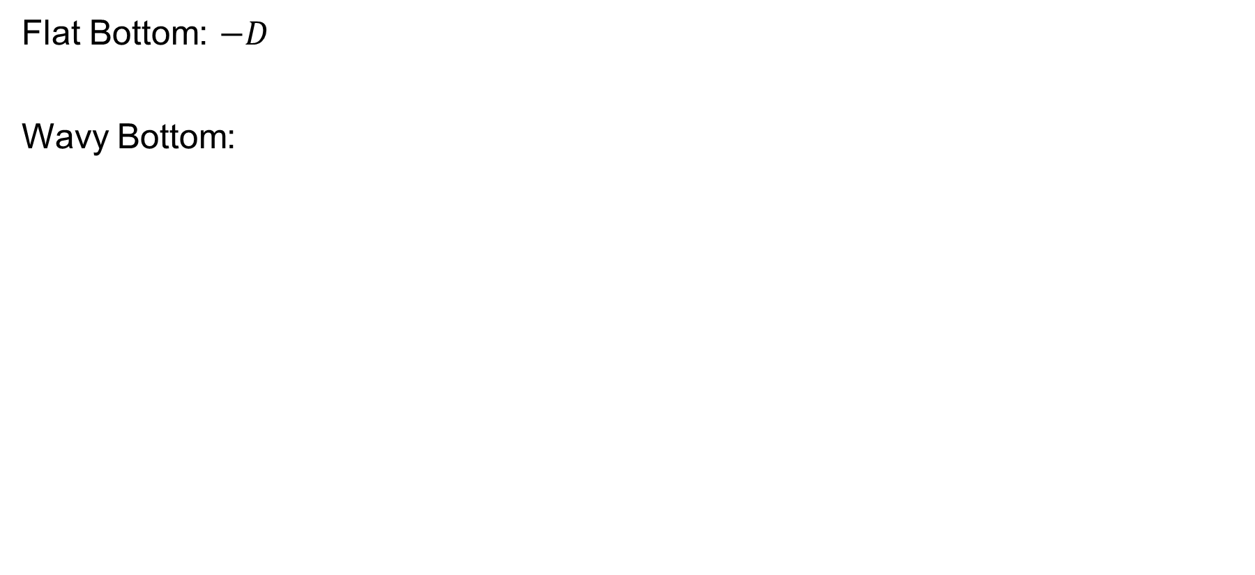
Problem Setup: Bed Profile
Flat Bottom: $−D$
Wavy Bottom:
function bed_profile(x, use_wavy_bed, D)
N = length(x)
zb = -D .* ones(N)
if use_wavy_bed
zb .+= 0.4 .* sin.(2π .* x .* (N - 1) ./ (N * (x[end] - x[1]) * 5))
end
return zb
End

Slide 5
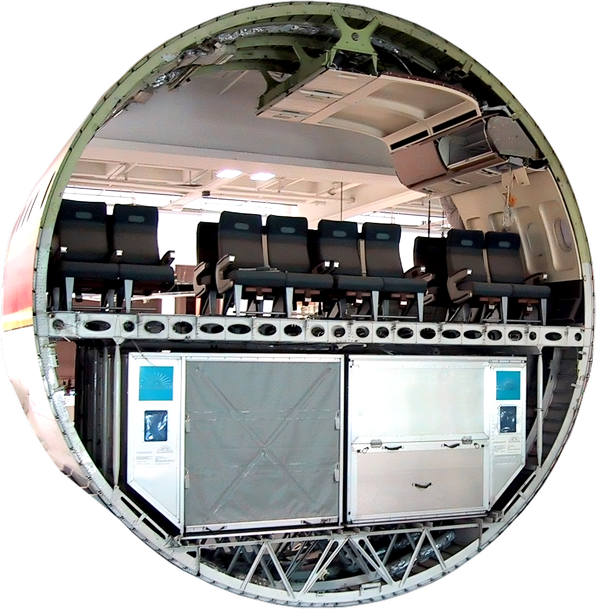
Problem Setup: Calculating Initial Conditions
function initial_conditions(params::SWEParameters)
xmin, xmax = params.xspan
ζ = 0.1 .* exp.(-100 .* ((params.x ./ xmax .- 0.5) .* xmax).^2)
h = ζ .- params.zb # total water depth
q = zeros(length(params.x)) # initial discharge
return h, q
end

Slide 6
Problem Setup: Calculating Residuals (Periodic BC)
# For periodic boundary conditions:
if p.bc_type == :periodic
# Apply periodic ghost cells
h_ext = [h[end]; h; h[1]]
q_ext = [q[end]; q; q[1]]
zb_ext = [zb[end]; zb; zb[1]]
ζ_ext = h_ext .+ zb_ext
# Spatial derivatives (central difference)
dqdx = @. (q_ext[3:end] - q_ext[1:end-2]) / (2Δx)
residual[1:N] .= dhdt .+ dqdx
q2_over_h = @. q_ext[2:end-1]^2 / h_ext[2:end-1]
q2_over_h_ext = [q2_over_h[end]; q2_over_h; q2_over_h[1]]
dfluxdx = @. (q2_over_h_ext[3:end] - q2_over_h_ext[1:end-2]) / (2Δx)
dzetadx = @. (ζ_ext[3:end] - ζ_ext[1:end-2]) / (2Δx)
friction = @. p.cf * q .* abs(q) / h.^2
residual[N+1:2N] .= dqdt .+ dfluxdx .+ p.g .* h .* dzetadx .+ friction

Slide 7
Smoothing Set-up
Minmod Slope Limiter
MUSCL Reconstruction
Rusanov numerical flux

Slide 8
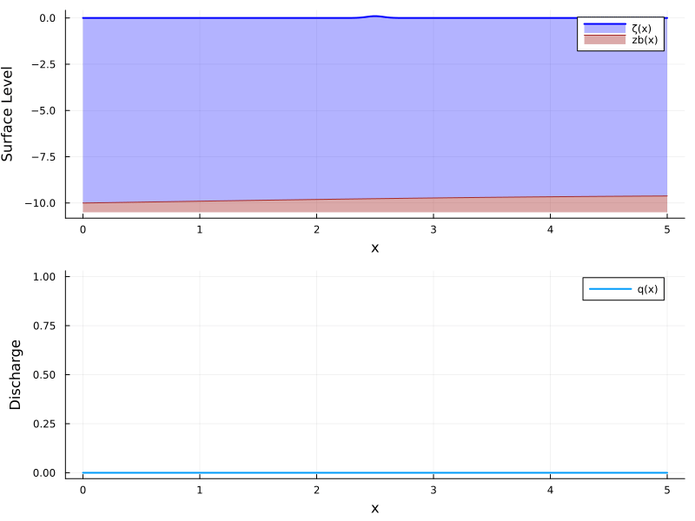
Not Smoothing PBC

Slide 9

With Smoothing PBC

Slide 10
Problem Setup: Dirichlet BC
elseif p.bc_type == :dirichlet_neumann
# Prescribed BCs
qL = p.prescribed_inlet_discharge(t)
ζR = p.prescribed_outlet_surface(t)
# Extend fields with ghost cells
q_ext = [qL; q; q[end]] # Dirichlet on q at left
ζ_ext = [ζ[1]; ζ; ζR] # Dirichlet on ζ at right
h_ext = [h[1]; h; ζR - zb[end]] # derive h ghost from ζR - zb
zb_ext = [zb[1]; zb; zb[end]] # Neumann (copy value)
# ∂q/∂x (mass conservation)
dqdx = @. (q_ext[3:end] - q_ext[1:end-2]) / (2Δx)
residual[1:N] .= dhdt .+ dqdx
# convective term ∂/∂x (q²/h)
q2_over_h = @. q_ext[2:end-1]^2 / h_ext[2:end-1]
q2_over_h_ext = [q2_over_h[1]; q2_over_h; q2_over_h[end]] # Neumann-like
dfluxdx = @. (q2_over_h_ext[3:end] - q2_over_h_ext[1:end-2]) / (2Δx)
# surface gradient ∂ζ/∂x
dzetadx = @. (ζ_ext[3:end] - ζ_ext[1:end-2]) / (2Δx)
# friction
friction = @. p.cf * q * abs(q) / h^2
residual[N+1:2N] .= dqdt .+ dfluxdx .+ p.g .* h .* dzetadx .+ friction

Slide 11
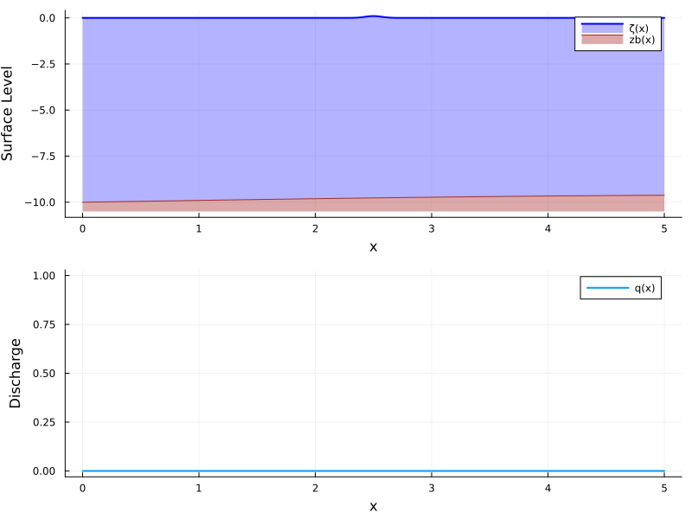

Not Smoothing dirichlet
$$q_{in}=1.0$$
$$ζ_{out}=−1.0$$

Slide 12


With Smoothing dirichlet
$$q_{in}=1.0$$
$$ζ_{out}=−1.0$$

Slide 13





Github repository:
https://github.com/Philipwur/DUCOMS2025
QAIMS website:
https://www.tudelft.nl/lr/qaims

